Slide 1
Big Data – Hadoop MapReduce
Lecture 5

Slide 2
Big Data Needs Big processing power
We have addressed storage requirements of Big Data through Hadoop HDFS, We also need scalable processing power to handle the 4 V’s of Big Data
Move from serial processing to parallel processing is essential
Need to move away from centralised to distributed processing to scale
Processing needs to be executed close to Data

Slide 3
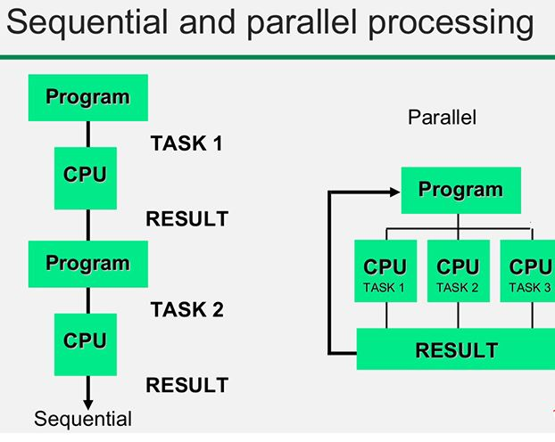

Slide 4
Background
A typical Personal computer works well for watching movies or working with spreadsheet
However, your computer is not powerful enough to perform tasks like data processing on very large data set. Single machines do not have enough power & resources to perform computations on huge amounts of data
A cluster (group of machines) pools resources of many machines together allowing the use of all the cumulative resources
A group of machines alone is not adequate - need a framework to coordinate work across them eg Mapreduce
Hadoop MapReduce manages and coordinates the execution of tasks on data across cluster of computers

Slide 5
What is MapReduce?
Built on the concept of divide and conquer by using distributed computing and parallel processing
Faster to break massive tasks into smaller chunks, allocate them to multiple servers and process them in parallel
Analogy – building a house with one person takes 12 months vs building a house with 12 person
Programming logic is placed as close to the data as possible
This approach is used for both structured and unstructured data

Slide 6
Sequential Word Count Pseudo Code
Hashtable wordCount;
for each document in set of documents{
Tokens = tokenise(document);
for each token in Tokens{
if(wordCount.contains(token))
wordCount(token, value++);
else
wordCount(token, 1);
}
}

Slide 7
Shortcomings of Sequential Word Count
Program will be slow as the number of files to be processed becomes large
If executed on a single computer
Processing speed can be improved by using more machines
Subsets of documents processed in parallel on each machine
When completed, all results are combined
Machine 1
Process subset
of files
Machine 2
Process subset
of files
Machine 3
Process subset
of files
Machine 4
Process subset
of files
Machine 5
Combine results

Slide 8
How to divide and conquer
Decompose the original problem in smaller, parallel tasks
Schedule tasks on workers or datanodes distributed in cluster – Data locality & Resource availability
Ensure workers get the data they need
Coordinate synchronisation among workers
Share partial results
Handle failures

Slide 9
MapReduce: Some Principles
Scale out and not scale up – use horizontal scaling rather than vertical scaling. A large number of commodity servers is preferred over a small number of high end servers
Move Processing to the Data – Distributed ﬁlesystems are necessary for this
Process Data Sequentially and Avoid Random Access: Disk performance for random disk access is poor and introduces complexity . Organise computation for sequential reads
Seamless Scalability - given a cluster twice the size, the same code should take no more than half as long to run
Designed for batch processing and full scan of dataset
Shared nothing approach (Shared memory approach more complicated eg concurrency, difficult to develop to)

Slide 10
What is MapReduce
Programming model that perform parallel and distributed processing on huge data sets
Computes huge amounts of data by applications, mapping and reducing steps to come up with solution
Runs on a distributed filesystem - HDFS
Hadoop and MapReduce are all about scaling out as opposed to scaling up
why?
Key concept is divide and conquer - break up a large data set into many smaller pieces and process them in parallel with the same algorithm
With Distributed file system (HDFS) the files are already divided into bite sized pieces (Blocks – default size 128MB). MapReduce is what you use to process all the pieces
MapReduce persists back to the disk after a map or reduce action

Slide 11
MapReduce high level overview
In the Map phase of MapReduce, records from a large data source are divided up and processed across as many servers as possible in parallel to produce intermediate values
After Map processing is completed the intermediate results are collected and combined or reduced into final value

Slide 12
MapReduce advantages
Parallel Processing: By dividing the job among multiple nodes and each node works with part of the job simultaneously - time taken to process data gets reduced significantly
Data Locality: Instead of moving data to the processing unit, we move the processing unit to the data
In traditional system, we bring data to processing unit and process it. As data grew and became very huge, bringing huge amount of data to the processing unit posed following issues:
Moving huge data to processing is costly and deteriorates the network performance
Processing takes time as the data is processed by a single unit which becomes the bottleneck eg moving 10 TB is impractical!

Slide 13
Understanding Hadoop MapReduce By Example
Hadoop is fundamentally a batch data processing system
Big advantage is easy scaling of data processing
Using multiple computer nodes
Consider the classic Hadoop example
To count the occurrences of each word in a series of text files
The steps to achieve this are:
Create a counter for each word and set it to zero
For each document one by one:
Break up the document into individual words
For each occurrence of a word, add one to its counter
Display each word with its total count

Slide 14
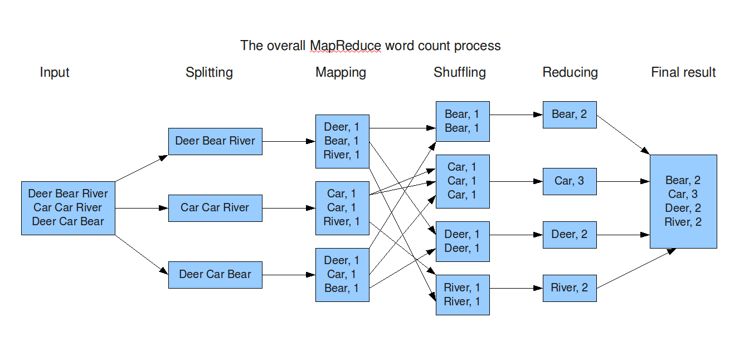
Applying Hadoop to Word Count

Slide 15
Map Reduce Stages
Step 1: Splitting
Breaks input data into segments for processing by individual machines /nodes
Word Count example breaks a file into lines of text
This forms the input to the Map stage
Step 2: Mapping
Formulates data as a set of <key, value> pairs for processing
Word Count example breaks input into <word, count> pairs
One entry for each word

Slide 16
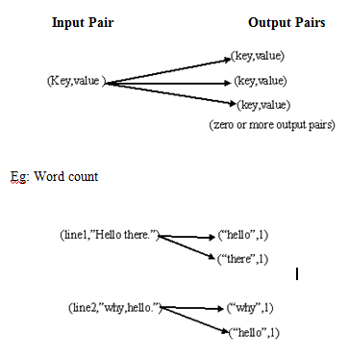
Step 2 - Mapping

Slide 17
Map Reduce Stages (ii)
Step 3 : Shuffling
Moves mapped data with the same key to the same reducer machine
Word Count example moves each <key, value> pair with the same key to the same machine
This results in all the <word, count> pairs for the same words being on the same reducer machine
Shuffling places data on correct machines for the reducing stage
Data is again <key, value pairs>
Value is now the count of the occurrences of the word
Step 4: Reducing
Takes user-supplied program reduces <key, value> pairs
Word Count example simply sums the occurrences of each word

Slide 18
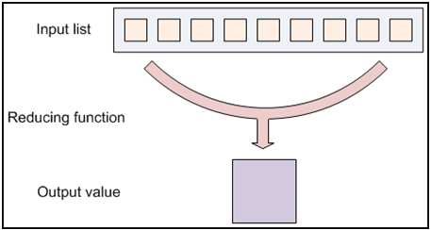
Step 4 - Reduce
Aggregates values together. The reducer function access an iterates of input values from an input list and it then combines together to returning a single output value

Slide 19
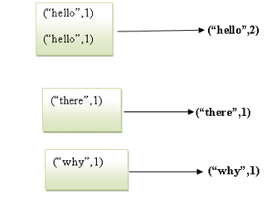
Step 4 - Reduce

Slide 20
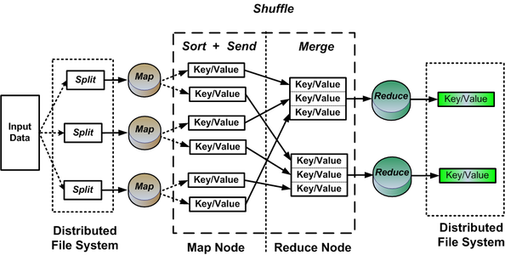
MapReduce Data flow

Slide 21
MapReduce Job consists of
A dataset stored on the underlying distributed ﬁlesystem, which is split in a number of ﬁles across machines
The mapper is applied to every input key-value pair to generate intermediate key-value pairs
The reducer is applied to all values associated with the same intermediate key to generate output key-value pairs

Slide 22
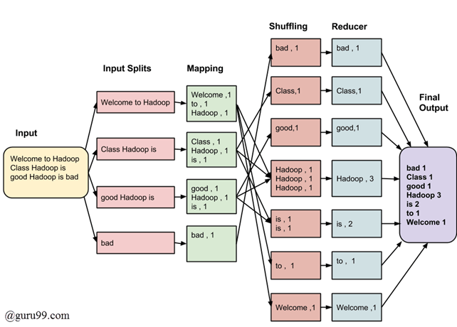
MapReduce Architecture

Slide 23
MapReduce Architecture explained
More efficient to have multiple splits as time taken to process a split is small compared to the time taken for processing of the whole input
Smaller splits is better as processing can be processed in parallel
Splits too small in size can have large overhead as managing the splits and map task creation thereby increasing the total job execution time
Normally best for split size equal to the size of HDFS block (128 MB)
Execution of map tasks results in writing output to a local disk on the Datanode and not to HDFS
Why?

Slide 24
MapReduce Architecture explained (Continued)
Writing Map output to local disk rather than HDFS avoids replication which takes place in HDFS. Map output can be discarded and storing it in HDFS with replication is over the top!
In case of node failure before the map output is consumed by the reduce task, Hadoop reruns the map task on another node and re-creates the map output
Data Locality concept is not used by reduce task
Output of every map task is fed to the reduce task & map output transferred to machine where reduce task is executing
Reduce output is stored in HDFS - first replica is stored on the local datanode and other replicas stored in a rack aware manner

Slide 25
Understanding MapReduce
HDFS breaks down very large files into large blocks (eg 128MB), and stores three copies of these blocks on different datanodes in the cluster
In YARN (resource management & scheduler) when a MapReduce job is started the Resource Manager (the cluster resource management and job scheduling facility) creates an Application Master process to manage lifecycle of the job
Application Master determines which file blocks are needed for processing and requests details from the NameNode on where the replicas data blocks are stored
Application Master makes requests to the Resource Manager to have map tasks process specific blocks on the DataNode where stored.
Key to efficient MapReduce processing is data is processed locally - on the Datanode where it is stored

Slide 26
Key Value Pair and MapReduce
Key-Values pair is an open ended data structure with key identifier and associated value. Eg “Firstname”: “Sanjeev”
MapReduce application processes the data in input splits on a record-by-record basis and that each record is understood by MapReduce to be a key/value pair
Byte offset is used as key rather then row number as byte offset is more precise because every block has a fixed number of bytes
Map Phase - After the input splits have been calculated, the mapper tasks can start processing them - right after the Resource Manager scheduling facility assigns them their processing resources

Slide 27
After the Map phase there is a Shuffle
Data from the mapper tasks is moved to the nodes where the reducer tasks will be run
When the mapper task is complete, the results are sorted by key and written to disk
To optimise performance, MapReduce process data is immediately moved to the reducer tasks nodes to avoid a flood of network activity when the final mapper task completes its task
This transfer happens while the mapper task is running, as the outputs for each record are stored in the memory of a waiting reducer task

Slide 28
Shuffle and Reduce phase
Despite the reducer task having most of the mapper task output, the reduce task processing does not begin until all mapper tasks have completed
If there is a poorly performing mapper task on a Datanode, the MapReduce framework uses a concept called speculative execution - If some mapper tasks are running slower than what is considered reasonable, the Application Master will start a duplicate tasks. Whichever task finishes first (duplicate or original) their results are stored to disk and the other task is terminated.
Speculative execution is enabled by default for both map and reduce tasks
Output from mapper tasks is not written to HDFS but rather to local disk where the mapper task was run

Slide 29
MapReduce Disk IO explained
When MapReduce job starts, the first step is to read data from disk and run mappers. The output of mappers is stored back on disk.
Next Shuffle and sort step starts and reads the mapper output from disk and after shuffle and sort completes, it stores the result back on disk
Finally the reduce step starts, reads the output from shuffle and sort step and finally stores the result back in HDFS
That is six disk accesses to complete the job
There are performance implications of this IO!

Slide 30
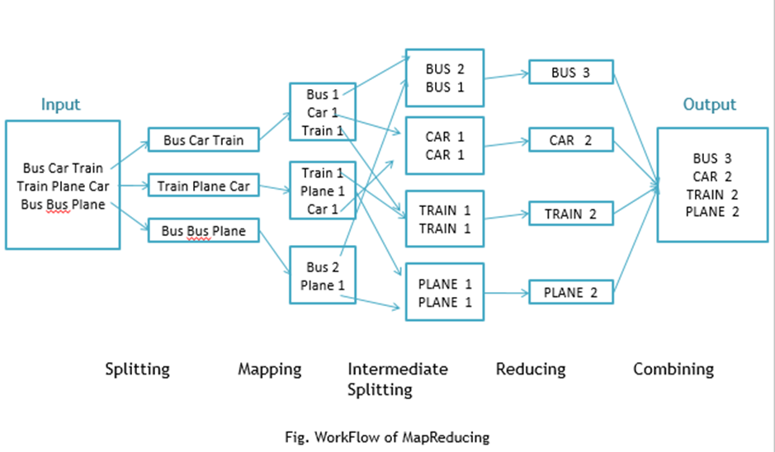

Slide 31
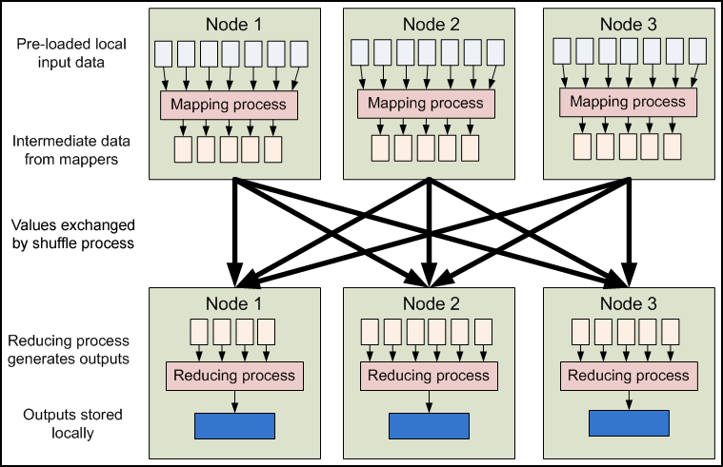
Data flow of MapReduce
MapReduce inputs typically come from input files loaded onto our processing cluster in HDFS. These files are evenly distributed across all our nodes. Running a MapReduce program involves running mapping tasks on many nodes in our cluster. Each of these mapping tasks is equivalent: therefore, any mapper can process any input file. Each mapper loads the set of files local to that machine and processes them.
When the mapping phase has completed, the intermediate (key, value) pairs must be exchanged between machines to send all values with the same key to a single reducer. The reduce tasks are spread across the same nodes in the cluster as the mappers. This is the only communication step in MapReduce. Individual map tasks do not exchange information with one another, nor are they aware of one another's existence. Similarly, different reduce tasks do not communicate with one another. The user never explicitly marshals information from one machine to another; all data transfer is handled by the Hadoop MapReduce platform itself, guided implicitly by the different keys associated with values

Slide 32
MapReduce is not for Iterative computation
Iterative computations that need to pass over the same data many times is not suited to Mapreduce as it does not cache data
MapReduce kills its processes as soon as a job is done
It is ideal when it comes to one pass ETL type jobs, for example, data transformation or data integration – this is what it was designed for

Slide 33
Summary - How MapReduce organises work
Hadoop divides the job into tasks:
Map tasks (Splits & Mapping)
Reduce tasks (Shuffling, Reducing)
Execution of Map and Reduce tasks in Hadoop 1 is controlled by two types of entities called a
Jobtracker: Acts like a master (responsible for complete execution of submitted job)
Multiple Task Trackers: Acts like slaves, each of them performing the job

Slide 34
Challenges for Hadoop & MapReduce
Batch processing: Hadoop running MapReduce has been most deployed in batch processing environments which is limited
Performance: Hadoop and MapReduce does a lot of read/write with disk drives & is slow. As data volumes and user expectations grow these slowdowns become less acceptable (Spark addresses this)
Supporting multiple software versions: Open source software often has endless updates. Organisation with in house hosting find it necessary to run multiple versions of their open software software at the same time with an increasing collection of data silos
It is complex: While Hadoop and MapReduce application are simpler than previous application development approach, it is still complex with a steep learning curve

Slide 35
Hadoop MapReduce Summary
Pros
Good for processing large, unstructured data sets
When your processing can easily be made parallel
When running batch jobs is acceptable
Cons
Requires knowledge of Java, Scala or Python programming languages
Increases lead time prior to data analysis
Not suitable for interactive analysis
Not suitable for intense calculations with little of no data

Slide 36
Tez (fast in Hindi)
Apache Tez improves on MapReduce performance while maintaining MapReduce ability to scale to petabytes of data
The first diagram on next slide illustrates a process that has multiple MapReduce jobs each storing intermediate results to the HDFS – the reducers of the previous step feeding the mappers of the next step
The second diagram on the next slide illustrates how with Tez the same processing can be done in just one job with no need to access HDFS in between (and no expensive IO!)
Tez flexibility and performance improvement requires more effort than MapReduce to start consuming; there is a bit more API and a bit more processing logic that needs to implement

Slide 37
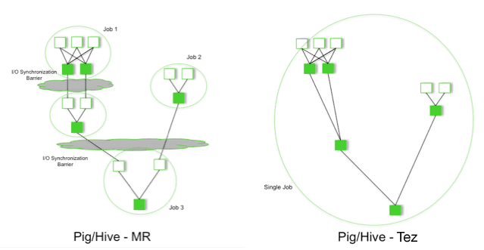

Slide 38
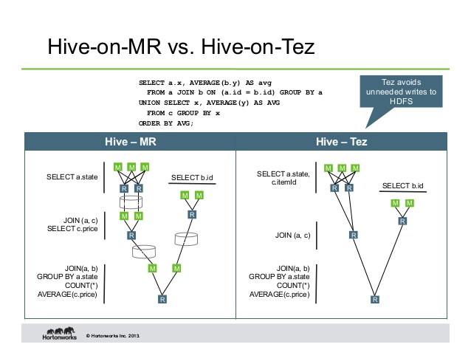

Slide 39
How Hadoop V1 MapReduce organises work
A job is divided into multiple tasks which are then run onto multiple data nodes in a cluster
Job tracker coordinates the activity by scheduling tasks to run on different data nodes
Execution of individual task is done by task tracker which resides on every data node which is executing the job
Task tracker sends the progress report to the job tracker
Job tracker keeps track of the overall progress of each job. In the event of task failure, the job tracker can reschedule it on a different task tracker.
This design resulted in scalability bottleneck due to a single Job Tracker

Slide 40
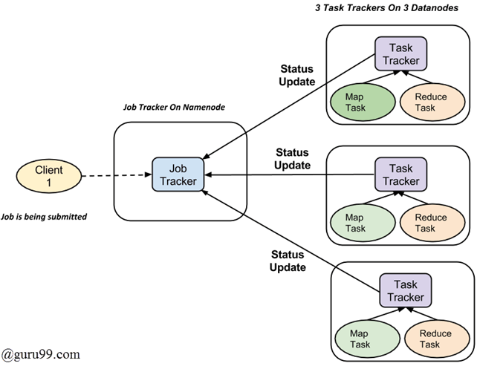
How MapReduce organises work

Slide 41
YARN (Yet Another Resource Negotiator)
YARN pulls together storage unit of Hadoop (HDFS) with the various processing tools like MapReduce
Is general purpose resource management facility that schedule and assign CPU cycles and memory from the Hadoop cluster to applications
Provides more efficient and flexible workload scheduling as well as a resource management facility which enable Hadoop to run more than just MapReduce jobs

Slide 42
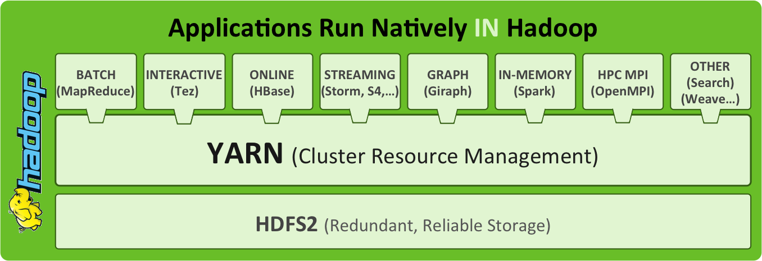

Slide 43
YARN Architecture consists of
Resource Manager - Runs on a master daemon (typically on the same server as the namenode) and manages the resource allocation in the cluster
Node Manager - run on the slave daemons (datanode) and responsible for the execution of a task
Application Master - Manages the user job lifecycle and resource needs of individual applications. It works along with the Node Manager and monitors the execution of tasks
Container - Package of resources including RAM, CPU, on a node

Slide 44
YARN Resource Manager
Resource Manager governs all the data processing resources in the Hadoop cluster. It is a dedicated scheduler that assigns resources to requesting applications.
The Resource Manager is critical component in a Hadoop cluster
YARN is scalable and able to provide a generic platform for applications and able to support a multi-tenant Hadoop cluster - multi-tenant because different business units can share the same Hadoop cluster.

Slide 45
YARN Node manager
Each slave node has a Node Manager daemon which acts as slave for the Resource Manager
Each Node Manager tracks the available data processing resources on its slave node and sends regular reports to the Resource Manager.
The processing resources in Hadoop cluster are consumed in bite-size pieces called containers. A container is a collection of all the resources necessary to run an application: CPU cores, memory, and disk space. A deployed container runs as an individual process on a slave node in a Hadoop cluster.
All container processes running on a slave node are initially provisioned, monitored, and tracked by that slave node Node Manager daemon.

Slide 46
YARN Application Master
Application running on Hadoop cluster has its own, dedicated Application Master instance which runs in a container process on a slave node
Throughout its life while the application is running, the Application Master sends heartbeat messages to the Resource Manager with its status and the state of the application’s resource needs.
the Resource Manager assigns container resource leases - reservations for the resources containers need to the Application Master on specific slave nodes
The Application Master oversees the full lifecycle of an application, all the way from requesting the needed containers from the Resource Manager to submitting container lease requests to the NodeManager

Slide 47
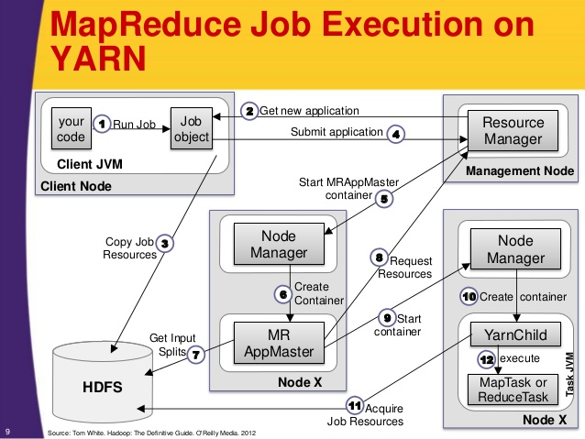

Slide 48
MapReduce Video
https://www.youtube.com/watch?v=bcjSe0xCHbE

